Slide 1
Discussion Module:
Wrap up remainder of Text Analytics.
Not these, these are coming-
A better treatment of query predicate, query functions, other.
Geospatial/spatial (time series)
Capacity planning, tuning
DSE Search, Text Analytics - Part 2
Notes:
The goal of this Discussion Module is to complete the text area of DSE Search.
Still coming (other modules):
A more complete discussion of query syntax, capability
Geospatial/spatial (time series)
Capacity planning, tuning

Slide 2
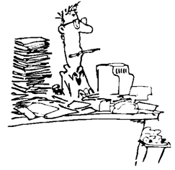
Discussion Lab:
What do you have, What do you need-
Notes:
On the next page we enter a Discussion Lab.

Slide 3
Amazon, Uber Eats: Name 3 You Have|Need
Notes:
Discussion Lab:
Name three features from DSE Search that would help you deliver Amazon or Uber Eats-
Name three features you still require-

Slide 4
End of Discussion Lab:
Notes:
End of Discussion Lab-

Slide 5
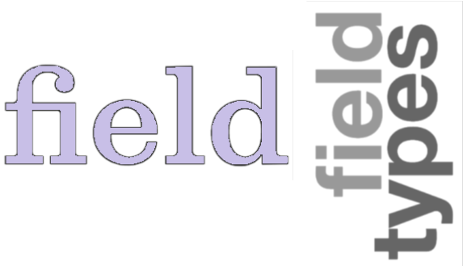
DSE Search (Derived Fields)
( Derived fields )
copyField
dynamicField (pass until Geospatial)
(Default Field)
( Field Transformers )
Notes:
There is no official DSE Search entity titled, derived fields.
Derived fields is our term to group; copyField, dynamicField, (default field), and ( Field Transformers ).
copyField, dynamicField, and Field Transformers are not field type properties or field properties; they are their own objects. (Default field is a config property; every other topic has been a schema property or object.)

Slide 6

copyField: Its own object, ALTER SEARCH INDEX .. ADD copyField..
Use cases:
Need multiple treatments (different analyzers) for a given field (multiValued=false okay)
Group multiple query attributes to a single location (ease of use, a default field)
multiValued = false // Attractive, but ..
multiValued = true // Required for M:1
Other
Source fields not stored in index. (No source fields are stored in index.)
Destination field not stored in DSE table proper. (No key column data is stored in the table proper.)
Notes:
There is a syntax to create a copyField with the original CREATE SEARCH INDEX syntax, but we’ll pass on that. You get a generated new column name, which is fine, but you likely will want other changes too; better to run an ALTER SEARCH INDEX statement for full control.
When copying multiple source fields into one destination field:
multiValued=true, is what the Solr documentation states is required. This creates, in effect, a set of tokens.
multiValued=false, appears to work until you accurately test it; it appears it would provide a superior query experience. (At first it appears you could query a single string constant easily; preserve token order. We demonstrate this later in this module.)
Reference Urls:
https://docs.datastax.com/en/datastax_enterprise/4.8/datastax_enterprise/srch/srchCpyFld.html
https://docs.datastax.com/en/datastax_enterprise/4.8/datastax_enterprise/srch/srchExCpyFld.html
https://docs.datastax.com/en/datastax_enterprise/5.0/datastax_enterprise/srch/storedFalseCopyField.html
https://docs.datastax.com/en/datastax_enterprise/5.0/datastax_enterprise/srch/copyFieldDocValueExample.html
https://docs.datastax.com/en/dse/5.1/cql/cql/cql_reference/cql_commands/cqlAlterSearchIndexSchema.html#cqlAlterSearchIndex__example

Slide 7

End to End Example:
copyField
Notes:
At this point we present an example; complete, and end to end.
The example we detail is copyField, and testing related to same.

Slide 8

copyField example .. page 1 of 10
DROP KEYSPACE ks_7449;
CREATE KEYSPACE ks_7449 WITH REPLICATION =
{'class': 'SimpleStrategy', 'replication_factor': 1};
USE ks_7449;
CREATE TABLE t6
(
col1 TEXT,
col2 TEXT,
col3 TEXT,
col4 TEXT,
col5 TEXT,
col6 TEXT,
col7 TEXT,
col8 TEXT,
col9 TEXT,
col0 TEXT,
PRIMARY KEY ((col1, col2)) );
CREATE SEARCH INDEX ON t6 WITH COLUMNS col1,
* { excluded : true };
Notes:
On this page we begin a long code example we use to explore DSE Search copyField.
Unless otherwise stated; each command that follows is a CQL DDL/DML command.

Slide 9
copyField example .. page 2 of 10
INSERT INTO t6
(col1, col2, col3, col4, col5,
col6, col7, col8, col9, col0)
VALUES ('aaa', 'aaa', 'StarBucks', 'aaa', 'aaa',
'aaa', 'aaa', 'aaa', 'aaa', 'aaa');
VALUES ('bbb', 'bbb', 'bbb', 'Chuck', 'David',
'Todd', 'bbb', 'bbb', 'bbb', 'bbb');
VALUES ('ccc', 'ccc', 'ccc', 'Chuck', 'Mary',
'Lincoln', 'ccc', 'ccc', 'ccc', 'ccc');
VALUES ('ddd', 'ddd', 'ddd', 'David', 'Chuck',
'Todd', 'ddd', 'ddd', 'ddd', 'ddd');
Notes:
The data used in this example.

Slide 10


copyField example .. page 3 of 10
ALTER SEARCH INDEX SCHEMA ON t6
ADD fields.field[@name='col3', @type='StrField',
@indexed='false', @multiValued='false', @stored='false'];
ALTER SEARCH INDEX SCHEMA ON t6
ADD fieldType[@name='TextField71',
@class='solr.TextField'] WITH
'{"analyzer":{"tokenizer":{"class":
"solr.KeywordTokenizerFactory"},
"filter":[{"class":"solr.LowerCaseFilterFactory"}]}}';
ALTER SEARCH INDEX SCHEMA ON t6
ADD fieldType[@name='TextField72',
@class='solr.TextField'] WITH
'{"analyzer":{"tokenizer":{"class":
"solr.KeywordTokenizerFactory"},
"filter":[{"class":"solr.BeiderMorseFilterFactory"}]}}';
indexed=false
Notes:
Comments related to the code above:
Can col3 be used to sort ?
Can we predicate on col3 ?
Field types 71 and 72 prepare for lowercase search, and sounds like search.

Slide 11
copyField example .. page 4 of 10
ALTER SEARCH INDEX SCHEMA ON t6
ADD fields.field[@name='col71',
@type='TextField71', @indexed='true', @multiValued='false',
@stored=‘false’];
ALTER SEARCH INDEX SCHEMA ON t6
ADD fields.field[@name='col72',
@type='TextField72', @indexed='true', @multiValued='false',
@stored=‘false'];
ALTER SEARCH INDEX SCHEMA ON t6
ADD copyField[@source='col3', @dest='col71'];
ALTER SEARCH INDEX SCHEMA ON t6
ADD copyField[@source='col3', @dest='col72'];
RELOAD SEARCH INDEX ON t6;
REBUILD SEARCH INDEX ON t6;
Notes:
Syntax for the ADD copyField switch to ALTER SEARCH INDEX-

Slide 12
copyField example .. page 5 of 10
SELECT col1, col3 FROM t6
WHERE col1 = 'aaa' ;
// Fails, no index on col3
SELECT col1, col3 FROM t6
WHERE col3 = 'StarBucks';
// Fails, field not in table, needs solr_query predicate
SELECT col1, col3 FROM t6
WHERE col71 = 'StarBucks';
SELECT col1, col3 FROM t6
WHERE solr_query = '{ "q" : "col71:starbucks"}';
SELECT col1, col3 FROM t6
WHERE solr_query = '{ "q" : "col72:starbux"}';
why ?
Notes:
For each of the five queries above:
Which return data ?
Which fail and why ?

Slide 13
copyField example .. page 6 of 10
ALTER SEARCH INDEX SCHEMA ON t6
ADD fields.field[@name='col4', @type='StrField',
@indexed='false', @multiValued='false', @stored='false'];
ALTER SEARCH INDEX SCHEMA ON t6
ADD fields.field[@name='col5', @type='StrField',
@indexed='false', @multiValued='false', @stored='false'];
ALTER SEARCH INDEX SCHEMA ON t6
ADD fields.field[@name='col6', @type='StrField',
@indexed='false', @multiValued='false', @stored='false'];
ALTER SEARCH INDEX SCHEMA ON t6
ADD fields.field[@name='col73', @type='StrField',
@indexed='true', @multiValued='false', @stored=false'];
ALTER SEARCH INDEX SCHEMA ON t6
ADD fields.field[@name='col74', @type='StrField',
@indexed='true', @multiValued='true', @stored=‘false'];
sortable ?
Notes:
Adding three more columns to the DSE Search index (metadata).
Adding the two new indexed fields, TextField yes, but KeywordTokenizer.
Could you sort on col73 or col74 ?

Slide 14
copyField example .. page 7 of 10
ALTER SEARCH INDEX SCHEMA ON t6 ADD copyField[@source='col4',
@dest='col73', @stored='false'];
ALTER SEARCH INDEX SCHEMA ON t6 ADD copyField[@source='col5',
@dest='col73', @stored='false'];
ALTER SEARCH INDEX SCHEMA ON t6 ADD copyField[@source='col6',
@dest='col73', @stored='false'];
ALTER SEARCH INDEX SCHEMA ON t6 ADD copyField[@source='col4',
@dest='col74', @stored='false'];
ALTER SEARCH INDEX SCHEMA ON t6 ADD copyField[@source='col5',
@dest='col74', @stored='false'];
ALTER SEARCH INDEX SCHEMA ON t6 ADD copyField[@source='col6',
@dest='col74', @stored='false'];
RELOAD SEARCH INDEX ON t6;
REBUILD SEARCH INDEX ON t6;
Notes:
Continuing the copyField example.
Three source fields, times two destinations, equals six commands
RELOAD, REBUILD

Slide 15

copyField example .. page 8 of 10
SELECT col1, col4, col5, col6 FROM t6
WHERE solr_query = '{ "q" : "col73:(Chuck David Todd)"}';
col1 | col4 | col5 | col6
------+-------+-------+---------
ddd | David | Chuck | Todd
bbb | Chuck | David | Todd
ccc | Chuck | Mary | Lincoln
SELECT col1, col4, col5, col6 FROM t6
WHERE solr_query = '{ "q" : "col74:(Chuck David Todd)"}';
col1 | col4 | col5 | col6
------+-------+-------+---------
ddd | David | Chuck | Todd
bbb | Chuck | David | Todd
ccc | Chuck | Mary | Lincoln
Hint: Could have a perfect 1.0 score
Notes:
Related to the queries above:
The parenthesis, in this context, are used to group terms applied to a single column equality.
Why is Chuck Mary Lincoln returned ?!

Slide 16
copyField example .. page 9 of 10
SELECT col1, col4, col5, col6 FROM t6
WHERE solr_query = '{ "q" : "col73:(+Chuck +David +Todd)"}';
SELECT col1, col4, col5, col6 FROM t6
WHERE solr_query = '{ "q" : "col74:(+Chuck +David +Todd)"}';
col1 | col4 | col5 | col6
------+-------+-------+------
ddd | David | Chuck | Todd
bbb | Chuck | David | Todd
why ?
Notes:
Related to the queries above:
In this content, plus or minus calls for; required, or negate/not-required.
Why is David Chuck Todd returned ?

Slide 17
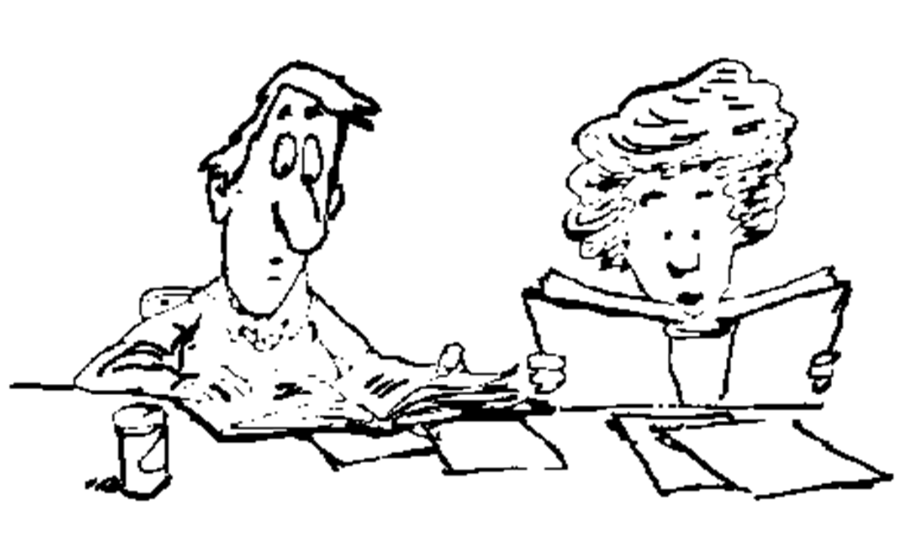

copyField example .. page 10 of 10
// Finds no rows
SELECT col1, col4, col5, col6 FROM t6
WHERE solr_query = 'col73:"Chuck David Todd"';
SELECT col1, col4, col5, col6 FROM t6
WHERE solr_query = 'col74:"Chuck David Todd"';
why ?
https://docs.datastax.com/en/dse/5.1/dse-dev/datastax_enterprise/search/queryTerms.html
https://docs.datastax.com/en/dse/5.1/dse-dev/datastax_enterprise/search/advancedTerms.html
Notes:
Related to the queries above:
In this context, the double quotes around Chuck David Todd present a phrase predicate.
Reference Urls,
https://docs.datastax.com/en/dse/5.1/dse-dev/datastax_enterprise/search/queryTerms.html
https://docs.datastax.com/en/dse/5.1/dse-dev/datastax_enterprise/search/advancedTerms.html

Slide 18
End to End Example:
copyField, Review
Notes:
This page marks the end of the (end to end) example; copyField using DSE Search.

Slide 19
dynamicField: Also its own object
Use cases:
Geospatial/spatial, definitely
Minimally; take a Lat/Lon pair, split, and allow for a two dimensional index
Pass for now-
Dynamic schemas ?? (Not with DSE)
Source: https://docs.datastax.com/en/dse/5.1/dse-dev/datastax_enterprise/search/usingDynamicFields.html
https://docs.datastax.com/en/dse/6.0/dse-dev/datastax_enterprise/search/unsupportedSearchFeatures.html
Notes:
dynamicField(s) are definitely used when using geospatial/spatial. There is discussion, largely on the Apache Solr side about their use.
Reference Urls,
https://docs.datastax.com/en/dse/5.1/dse-dev/datastax_enterprise/search/usingDynamicFields.html
https://docs.datastax.com/en/dse/6.0/dse-dev/datastax_enterprise/search/unsupportedSearchFeatures.html
Code to test (normal) dynamicField; does it generate new key fields using DSE Search-
DROP KEYSPACE IF EXISTS ks_16;
CREATE KEYSPACE ks_16 WITH REPLICATION =
{'class': 'SimpleStrategy', 'replication_factor': 1};
USE ks_16;
CREATE TABLE ks_16.t1
(
col1 TEXT,
col2 TEXT,
PRIMARY KEY ((col1))
);
INSERT INTO t1 (col1, col2) VALUES ('A', 'A');
INSERT INTO t1 (col1, col2) VALUES ('B', 'B');
INSERT INTO t1 (col1, col2) VALUES ('C', 'C');
CREATE SEARCH INDEX ON ks_16.t1 WITH COLUMNS col1 ;
ALTER SEARCH INDEX SCHEMA ON ks_16.t1 ADD dynamicField[@name='*_new', @type='StrField', @indexed='true', @stored='true'];
RELOAD SEARCH INDEX ON ks_16.t1;
REBUILD SEARCH INDEX ON ks_16.t1;
DESCRIBE ACTIVE SEARCH INDEX SCHEMA ON ks_16.t1;
//
// <?xml version="1.0" encoding="UTF-8" standalone="no"?>
// <schema name="autoSolrSchema" version="1.5">
// <types>
// <fieldType class="org.apache.solr.schema.StrField" name="StrField"/>
// </types>
// <fields>
// <field indexed="true" multiValued="false" name="col1" type="StrField"/>
// </fields>
// <uniqueKey>col1</uniqueKey>
// <dynamicField indexed="true" name="*_new" stored="true" type="StrField"/>
// </schema>
SELECT * FROM t1;
//
// col1 | col2 | solr_query
// ------+------+------------
// C | C | null
// B | B | null
// A | A | null
//
// (3 rows)
// --------------------------------------
ALTER TABLE t1 ADD col6_new TEXT;
INSERT INTO t1 (col1, col2, col6_new) VALUES ('D', 'D', 'D');
DESCRIBE TABLE t1;
//
// CREATE TABLE ks_16.t1 (
// col1 text PRIMARY KEY,
// col2 text,
// col6_new text,
// solr_query text
// ) WITH bloom_filter_fp_chance = 0.01
// AND caching = {'keys': 'ALL', 'rows_per_partition': 'NONE'}
// AND comment = ''
// AND compaction = {'class': 'org.apache.cassandra.db.compaction.SizeTieredCompactionStrategy', 'max_threshold': '32', 'min_threshold': '4'}
// AND compression = {'chunk_length_in_kb': '64', 'class': 'org.apache.cassandra.io.compress.LZ4Compressor'}
// AND crc_check_chance = 1.0
// AND dclocal_read_repair_chance = 0.1
// AND default_time_to_live = 0
// AND gc_grace_seconds = 864000
// AND max_index_interval = 2048
// AND memtable_flush_period_in_ms = 0
// AND min_index_interval = 128
// AND read_repair_chance = 0.0
// AND speculative_retry = '99PERCENTILE';
// CREATE CUSTOM INDEX ks_16_t1_solr_query_index ON ks_16.t1 (solr_query) USING 'com.datastax.bdp.search.solr.Cql3SolrSecondaryIndex';
DESCRIBE PENDING SEARCH INDEX SCHEMA ON ks_16.t1;
DESCRIBE ACTIVE SEARCH INDEX SCHEMA ON ks_16.t1;
//
// <?xml version="1.0" encoding="UTF-8" standalone="no"?>
// <schema name="autoSolrSchema" version="1.5">
// <types>
// <fieldType class="org.apache.solr.schema.StrField" name="StrField"/>
// </types>
// <fields>
// <field indexed="true" multiValued="false" name="col1" type="StrField"/>
// </fields>
// <uniqueKey>col1</uniqueKey>
// <dynamicField indexed="true" name="*_new" stored="true" type="StrField"/>
// </schema>
RELOAD SEARCH INDEX ON ks_16.t1;
REBUILD SEARCH INDEX ON ks_16.t1;
DESCRIBE PENDING SEARCH INDEX SCHEMA ON ks_16.t1;
DESCRIBE ACTIVE SEARCH INDEX SCHEMA ON ks_16.t1;
//
// <?xml version="1.0" encoding="UTF-8" standalone="no"?>
// <schema name="autoSolrSchema" version="1.5">
// <types>
// <fieldType class="org.apache.solr.schema.StrField" name="StrField"/>
// </types>
// <fields>
// <field indexed="true" multiValued="false" name="col1" type="StrField"/>
// </fields>
// <uniqueKey>col1</uniqueKey>
// <dynamicField indexed="true" name="*_new" stored="true" type="StrField"/>
// </schema>

Slide 20
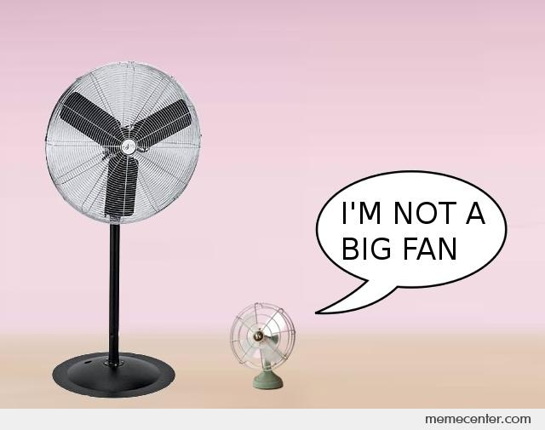
Default Field:
Use cases:
Handy ?
Word proximity; some predicate expressions are hard without presence of a default field
Config property, not schema property/object
edismax.uf ??
Notes:
The default field can be specified at the schema level, and also in the query proper. Not an object itself, (default field) is a field property.
Use cases:
Some word proximity predicates are hard to write without a default field.
edismax.uf, https://lucene.apache.org/solr/guide/6_6/the-extended-dismax-query-parser.html
The uf Parameter
Specifies which schema fields the end user is allowed to explicitly query. This parameter supports wildcards. The default is to allow all fields, equivalent to uf=*. To allow only title field, use uf=title. To allow title and all fields ending with '_s', use uf=title,*_s. To allow all fields except title, use uf=*,-title. To disallow all fielded searches, use uf=-*.

Slide 21
End to End Example:
(Default Field), and Word Proximity
Notes:
At this point we present an example; complete, and end to end.
The example we detail is (default field), and word proximity, and testing related to same.

Slide 22
Default Field Example .. page 1 of 5
DROP KEYSPACE IF EXISTS ks_7449;
CREATE KEYSPACE ks_7449 WITH REPLICATION =
{'class': 'SimpleStrategy', 'replication_factor': 1};
USE ks_7449;
CREATE TABLE t7
(
col1 TEXT PRIMARY KEY,
col2 TEXT,
col3 TEXT
);
Notes:
Example for (default field), using word proximity; no real new code.

Slide 23
Default Field Example .. page 2 of 5
INSERT INTO t7 (col1, col2, col3) VALUES
('aaa', 'test space' , 'test');
INSERT INTO t7 (col1, col2, col3) VALUES
('bbb', 'space test' , 'test');
INSERT INTO t7 (col1, col2, col3) VALUES
('ccc', 'test one two space' , 'test');
INSERT INTO t7 (col1, col2, col3) VALUES
('ddd', 'test one two three space' , 'test');
INSERT INTO t7 (col1, col2, col3) VALUES
('eee', 'test one two three four space', 'test');
CREATE SEARCH INDEX ON t7 WITH COLUMNS
col1, * { excluded : true };
Notes:
Adding data to our example; no real new code.

Slide 24
Default Field Example .. page 3 of 5
// KeywordTokenizer does not work here; need tokens
ALTER SEARCH INDEX SCHEMA ON t7
ADD fieldType[@name='TextField81',
@class='solr.TextField'] WITH
'{"analyzer":{"tokenizer":
{"class":"solr.StandardTokenizerFactory"} }}';
ALTER SEARCH INDEX SCHEMA ON t7
ADD fields.field[@name='col2', @type='TextField81',
@default='true'];
RELOAD SEARCH INDEX ON t7;
REBUILD SEARCH INDEX ON t7;
Can we ever sort on col2 ?
What is the (default) sort ?
Notes:
Word proximity requires a tokenizer more capable than KeywordTokenizer; without (tokens), given metadata does not exist to support proximity search.

Slide 25
Default Field Example .. page 4 of 5
SELECT * FROM t7 WHERE solr_query='col2:"test space"~10';
col1 | col2 | col3 | solr_query
------+-------------------------------+------+------------
aaa | test space | test | null
bbb | space test | test | null
ccc | test one two space | test | null
ddd | test one two three space | test | null
eee | test one two three four space | test | null
SELECT * FROM t7 WHERE solr_query='col2:"test space"~2';
aaa | test space | test | null
bbb | space test | test | null
ccc | test one two space | test | null
SELECT * FROM t7 WHERE solr_query='col2:"test space"~1';
aaa | test space | test | null
Notes:
Related to the queries above:
These are all phrase queries.
In this context, the tilde states; find these (m) words within (n) tokens.

Slide 26

Default Field Example .. page 5 of 5
// Fails with a,
// InvalidRequest: Error from server: code=2200 [Invalid query]
// message="no field name specified in query and no default specified
SELECT * FROM t7 WHERE solr_query='"test space"~2';
ALTER SEARCH INDEX CONFIG ON t7 SET defaultQueryField = 'col2' ;
RELOAD SEARCH INDEX ON t7;
REBUILD SEARCH INDEX ON t7;
SELECT * FROM t7 WHERE solr_query='"test space"~2';
Or, at least you know why this predicate works-
Notes:
Related to the queries above:
This simple word proximity example did not require a (default field), but many do.
Now you have the technique to set a schema level default field; or at least, you can discover (default field) conditions and understand them, and the query syntax related to same.

Slide 27
End to End Example:
(Default Field), and Word Proximity, Review
Notes:
This page marks the end of the (end to end) example; (default field) and word proximity using DSE Search.

Slide 28

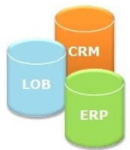
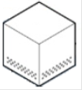



Field Transformers: Current landscape
https://www.datastax.com/dev/blog/dse-field-transformers
An eleven page article written using Java and Maven, this article walks you through the complete set of steps to design and implement.
In effect, take a value, store it in a DSE table, and upon insert/update (and delete), apply a (custom parser), pick out the specific and distinct data elements, and DSE Search index them.
There are only two Java classes you have to extend, FieldInputTransformer, and FieldOutputTransformer. Standard Java, and much of this Java code is boilerplate.
ETL/ELT
Newly created data stored in index, not in DSE table columns proper.
But, still super handy.
Notes:
There exists a capability with DSE Search title, field transformers.
In effect:
You can write a customer parser in Java; when the values arrives to be written to the DSE Search index, you can munge that value.
Like all DSE Search index key values, you will never see this value in the DSE table proper.

Slide 29


DSE Search Text Query Parsing, Scoring
0.16
.314
0
1.0
Text, score (relevancy)
Geospatial, geodist()
Spatial, dist(), other
Scalars (none, sort)
Notes:
Entering the subtopics of: results scoring, and query parsing.
Text is sorted by relevancy (the virtual column titled, score)
Geospatial and spatial are generally sorted by distance (from a point), or similar
Scalars are sorted however you want them to be.
Reference Urls:
https://www.slideshare.net/lucenerevolution/lucene-solr-4-spatial-extended-deep-dive
(Above), slide 45, “geodist() is for Solr 3 LatLonType only”.

Slide 30

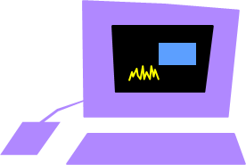
Database Server Backends: Stages
Parser
What do you know right now ?
Why are parser and (scoring) related ?
Q Optimizer
Q Processor
(Run time)
Client
Server
Notes:
Database servers employ a multi-stage back end between the client and the server. Generally:
The first stage is the parser; what are you asking the server to do ?
Then, assuming a SELECT/query, what run time resources are in place (indexes) that support execution of the query-
Query optimization
DSE Core, or DSE Search
Which predicates are better (more efficient)
Then the query is processed; ANDs, ORs, (unions, intersects, other)
And this all sits atop the file access libraries, other
To support a different scoring engine, you may need to submit different query syntax, and thus; you might need a different (new) query parser.

Slide 31

DSE Search (Lucene) Scoring Model, Part 1 of 2
Until Lucene 4, only Vector Space Model (Tf-Idf)
“Lucene Scoring Model”, the default; combination of VSM and Boolean (AND, OR)
Post Lucene 4-
(Scoring Model is pluggable)
Okapi BM (not common)
Language Model (Which words are common/rare in this language)
Divergence from Randomness (fraud, security)
Information-based (Sentiment)
tf, Term Frequency. Count per doc, higher == higher score
idf, Inverse Doc Freq. Count of term across all docs. Denominator in equation tf / (x), lower == higher score
coord, Coordinator Factor. Higher count of distinct terms found in given doc == higher score
fieldNorm, Field Length. More terms per doc == lower score
Source: http://www.solrtutorial.com/solr-search-relevancy.html
Notes:
Until Lucene version 4, the only (Lucene, Solr, DSE) scoring model was titled, Lucene Scoring Model. The Lucene Scoring Model is the intersection/combination of the Tf-Idf vector space model, and a set of boolean algebra (set operands on query predicates and their associated result sets).
Reference Urls:
Vector Space Model, Tf-Idf, https://en.wikipedia.org/wiki/Vector_space_model
Okapi (Best Match model: not common), https://en.wikipedia.org/wiki/Okapi_BM25
Language Model, How frequent is this word in the given language, https://en.wikipedia.org/wiki/Language_model
Divergence from Randomness, (greater weight to truly unique words: fraud, security), http://theses.gla.ac.uk/1570/
Information-based models, https://dl.acm.org/citation.cfm?id=1835490
This list above, https://lucidworks.com/2011/09/12/flexible-ranking-in-lucene-4/
https://lucene.apache.org/core/2_9_4/scoring.html
http://www.solrtutorial.com/solr-search-relevancy.html

Slide 32
DSE Search (Lucene) Scoring Model, Part 2 of 2
Pro:
Simple model based on linear algebra
Term weights not binary
Allows computing a continuous degree of similarity between queries and documents
Allows ranking documents according to their possible relevance
Allows partial matching
Con:
Long documents are poorly represented because they have poor similarity values (a small scalar product and a large dimensionality)
Search keywords must precisely match document terms; word substrings might result in a "false positive match
"Semantic sensitivity; documents with similar context but different term vocabulary won't be associated, resulting in a "false negative match“
The order in which the terms appear in the document is lost in the vector space representation
Theoretically assumes terms are statistically independent
Weighting is intuitive but not very formal
Scores not meaningful across queries
Score normalized; always between 0 and 1
Fast, hides complexity
Source: https://en.wikipedia.org/wiki/Vector_space_model
Notes:
Pros and cons related to the Lucene Scoring Model-

Slide 33
Score: Example, Part 1 of 2
Solr Admin UI
-> Core
-> Query TAB
-> fl = * , score
-> debugQuery=true
Notes:
Using the Solr Admin UI, under Core, then under Query, you can access all metadata related to; score, term frequency, other.

Slide 34
Score: Example, Part 2 of 2
"ddd": "0.7590632 = weight(col2:three in 4) [], result of: 0.7590632 = score
(doc=4,freq=1.0 = termFreq=1.0), product of: 0.87546873 = idf(docFreq=2, docCount=5)
0.86703634 = tfNorm, computed from: 1.0 = termFreq=1.0 1.2 = parameter k1
0.75 = parameter b 3.8 = avgFieldLength 5.2244897 = fieldLength“
"eee": "0.6454073 = weight(col2:three in 0) [], result of: 0.6454073 = score
(doc=0,freq=1.0 = termFreq=1.0), product of: 0.87546873 = idf(docFreq=2, docCount=5)
0.73721343 = tfNorm, computed from: 1.0 = termFreq=1.0 1.2 = parameter k1
0.75 = parameter b 3.8 = avgFieldLength 7.111111 = fieldLength"
Solr Admin UI
-> Core
-> Query TAB
-> fl = * , score
-> debugQuery=true
Notes:
Using the Solr Admin UI, under Core, then under Query, you can access all metadata related to; score, term frequency, other.

Slide 35
Scoring: q and fq (fq, not covered yet)
Most queries thus far (JSON) have been “q”, query predicate
“fq” are a further set of predicates applied to the results of “q”
Not a correlated subquery or similar, (no new columns, rows)
Just further (filtering)
fq filter activity does not affect score
Notes:
We have not covered filter queries (fq) yet. Filter queries are a further set of predicates that are applied to the original “q” set of query predicates.
Net/net; any “fq” activity does not affect the normal (q) score.

Slide 36
Boosting: Index and Query, Positive and Negative
Index time, No (Solr, Yes)
Query time, Yes
Using boost, omitNorms=false
(Not boost, save space, = true)
col4 | col5 | col5
-------+-------+-------
David | Chuck | Chuck
Chuck | Mary | Mary
Chuck | David | David
aaa | aaa | aaa
SELECT * FROM t6
WHERE solr_query =
'{ "q" : "(col73:%huck^8 OR
col74:chuck~1)" }' ;
Caret; pos value , alter the score for the given predicate (Only Lucene supports neg boost; Solr and thus DSE doesn’t)
Tilde (unrelated to boost) How many character misspellings
(Low numbers only.)
Notes:
Using the original sample table and data presented earlier in this module, we see:
An example of query boosting (“%huck”^8). The caret character is used to specify a boost value.
While Lucene supports negative boosting, Solr does not, thus; DSE Search does not.
The tilde is unrelated to boosting; it just found a nice home in this example.
The tilde permits fuzzy searching, in this case; misspellings.

Slide 37
Remainder of Field Type, Field Attributes
Notes:
Here we enter a subsection reviewing field type attributes and field attributes previously covered/not-covered.
Reference Urls:
https://lucene.apache.org/solr/guide/6_6/field-type-definitions-and-properties.html
https://lucene.apache.org/solr/guide/6_6/defining-fields.html
https://lucene.apache.org/solr/guide/6_6/field-properties-by-use-case.html

Slide 38
Discussion Lab:
Matching pairs – Match the field type and field properties on the right with the correct term on the left
Notes:
On the next page we enter a Discussion Lab.

Slide 39

Field Type, Field, Attributes: Covered
Field Type
Field
Name
Name
Class
Type
Notes:
Matching pairs Discussion Lab: properties of field types, fields, other.
Match the field properties on the right with the field type properties on the left.

Slide 40
Field Type, Field, Attributes: Covered
indexed=true
indexed=false
stored=t|f
Word Proximity
docValues=t|f
multiValued=true
Boosting, false=Y
multiValued=false
Highlighting, false=N
default=str
precisionStep=n
(Irrelevant, ignored)
positionIncrementGap=n
termVectors=t|f
(Space savings)
termPositions=t|f
multiValued
termOffsets=t|f
omitNorms=t|f
Notes:
Matching pairs Discussion Lab: properties of field types, fields, other.
Match the terms on the right with the correct term on the left.

Slide 41
Field Type, Field, Attributes: Covered
indexed=true
indexed=false
stored=t|f
docValues=t|f
copyField M:1
multiValued=true
multiValued=false
copyField 1:1
default=str
precisionStep=n
Collection
positionIncrementGap=n
termVectors=t|f
Non-collection
termPositions=t|f
termOffsets=t|f
omitNorms=t|f
Notes:
Matching pairs Discussion Lab: properties of field types, fields, other.
Match the terms on the right with the correct term on the left.

Slide 42
Field Type, Field, Attributes: Covered
indexed=true
indexed=false
stored=t|f
docValues=t|f
multiValued=true
StrField
multiValued=false
default=str
TextField
precisionStep=n
positionIncrementGap=n
TrieDoubleField
termVectors=t|f
termPositions=t|f
termOffsets=t|f
omitNorms=t|f
Notes:
Matching pairs Discussion Lab: properties of field types, fields, other.
Match the terms on the right with the correct term on the left.

Slide 43
Field Type, Field, Attributes: Covered
StrField
KeywordTokenizer
TextField
StandardTokenizer
TrieDoubleField
docValues
Word Proximity
docValues
Notes:
Matching pairs Discussion Lab: properties of field types, fields, other.
Match the terms on the right with the correct term on the left.

Slide 44
End of Discussion Lab:
Notes:
End of Discussion Lab-

Slide 45
Field Type, Field, Attributes: Not (Yet) Covered
autoGeneratePhraseQueries, For text fields. If true, Solr automatically generates phrase queries for adjacent terms. If false, terms must be enclosed in double-quotes to be treated as phrases.
enableGraphQueries, (needs graph query parser, not common)
docValuesFormat, (not common)
postingsFormat, (not common)
sortMissingFirst sortMissingLast, Control the placement of documents when a sort field is not present
Notes:
Two pages of field type attributes and field attributes not previously covered:
Some of these attributes are not relevant to DSE Search.
And the remainder are not commonly used.

Slide 46
Field Type, Field, Attributes: Not (Yet) Covered
omitTermFreqAndPositions, (related to omitForms), If true, omits term frequency, positions, and payloads from postings for this field. This can be a performance boost for fields that don’t require that information.
omitPositions, (related to omitNorms), Similar to omitTermFreqAndPositions but preserves term frequency information.
termPayloads. (related to other term*)
useDocValuesAsStored, (related to stored, not relevant)
large, (related to stored, not relevant)
default (related to stored, not relevant)
Notes:
Two pages of field type attributes and field attributes not previously covered:
Some of these attributes are not relevant to DSE Search.
And the remainder are not commonly used.

Slide 47
Limits, Unsupported Features

Slide 48
Unsupported Features/Limits: C* <-> DSE <-> Solr
Source: https://docs.datastax.com/en/dse/6.0/dse-dev/datastax_enterprise/search/unsupportedSearchFeatures.html
Notes:
(n) pages on the subtopics of what DSE Search supports, and doesn’t support from Apache Solr-
Reference Urls,
https://docs.datastax.com/en/dse/6.0/dse-dev/datastax_enterprise/search/unsupportedSearchFeatures.html

Slide 49
Unsupported Features/Limits: C* <-> DSE <-> Solr
Source: https://docs.datastax.com/en/dse/6.0/dse-dev/datastax_enterprise/search/unsupportedSearchFeatures.html
Notes:
(n) pages on the subtopics of what DSE Search supports, and doesn’t support from Apache Solr-
Reference Urls,
https://docs.datastax.com/en/dse/6.0/dse-dev/datastax_enterprise/search/unsupportedSearchFeatures.html

Slide 50
Unsupported Features/Limits: C* <-> DSE <-> Solr
Source: https://docs.datastax.com/en/dse/6.0/dse-dev/datastax_enterprise/search/unsupportedSearchFeatures.html
Notes:
(n) pages on the subtopics of what DSE Search supports, and doesn’t support from Apache Solr-
Reference Urls,
https://docs.datastax.com/en/dse/6.0/dse-dev/datastax_enterprise/search/unsupportedSearchFeatures.html

Slide 51
Unsupported Features/Limits: C* <-> DSE <-> Solr
Source: https://docs.datastax.com/en/dse/6.0/dse-dev/datastax_enterprise/search/unsupportedSearchFeatures.html
Notes:
(n) pages on the subtopics of what DSE Search supports, and doesn’t support from Apache Solr-
Reference Urls,
https://docs.datastax.com/en/dse/6.0/dse-dev/datastax_enterprise/search/unsupportedSearchFeatures.html

Slide 52
Unsupported Features/Limits: C* <-> DSE <-> Solr
Source: https://docs.datastax.com/en/dse/6.0/dse-dev/datastax_enterprise/search/unsupportedSearchFeatures.html
Notes:
(n) pages on the subtopics of what DSE Search supports, and doesn’t support from Apache Solr-
Reference Urls,
https://docs.datastax.com/en/dse/6.0/dse-dev/datastax_enterprise/search/unsupportedSearchFeatures.html

Slide 53
End of Module:
Notes:
End of Discussion Module-

Slide 54
Additional Content:
Notes:
The remaining content may be read “extra credit”, as time allows.

Slide 55
Analyzer: index or query
ALTER SEARCH INDEX SCHEMA ON t6
ADD fieldType[@name='TextFieldB1',
@class='solr.TextField'] WITH
'{"analyzer":{"type" : "index", "tokenizer":
{"class":"solr.KeywordTokenizerFactory"},
"filter":[{"class":"solr.LowerCaseFilterFactory"}]}}';
ALTER SEARCH INDEX SCHEMA ON t6
...
'{"analyzer":{"type" : “query", "tokenizer":
{"class":"solr.KeywordTokenizerFactory"},
...
SELECT col1, col4 FROM t6
WHERE solr_query = '{ "q" : "col4:david"}';
col1 | col4
------+-------
ddd | David
The analyzer attribute to set an analyzer as index-only, or query-only; the default is both.
Notes:
Example above how to set an analyzer as index-only, or query-only; the default is both.
In this case:
The data arrives in mixed case. The data is then indexed as lower case.
A query predicate that arrives lower case will find the row.

Slide 56
Phonetic Matching
Phonetic matching algorithms may be used to encode tokens so that two different spellings that are pronounced similarly will match.
For overviews of and comparisons between algorithms, see
http://en.wikipedia.org/wiki/Phonetic_algorithm
http://ntz-develop.blogspot.com/2011/03/phonetic-algorithms.html
Algorithms this category are:
Beider-Morse Phonetic Matching (BMPM)
Daitch-Mokotoff Soundex
Double Metaphone, Metaphone
SoundexRefined Soundex
Caverphone
Kölner Phonetik a.k.a. Cologne Phonetic
NYSIIS

